Slide 1
True Bearings, Angles of Elevation and depression

Slide 2
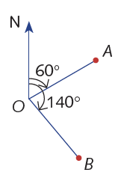
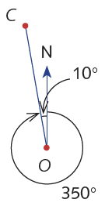

True bearings
True bearings give the angle $θ$ from the NORTH, measured CLOCKWISE.

Slide 3
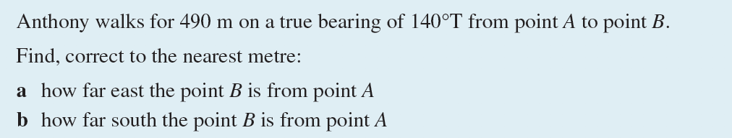
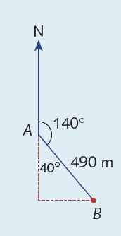

Slide 4
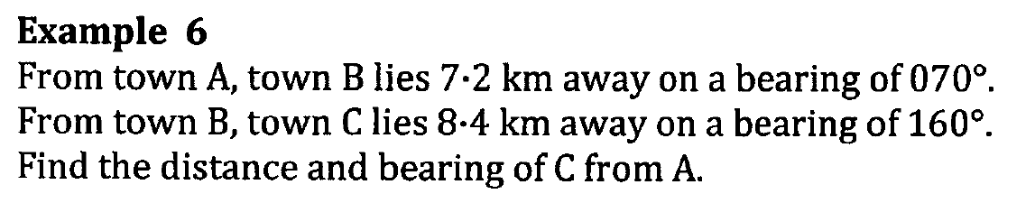

Slide 5
Angle of elevation
Angle of depression
Notes:
http://www.bbc.co.uk/education/guides/zq4w7ty/revision/4

Slide 7
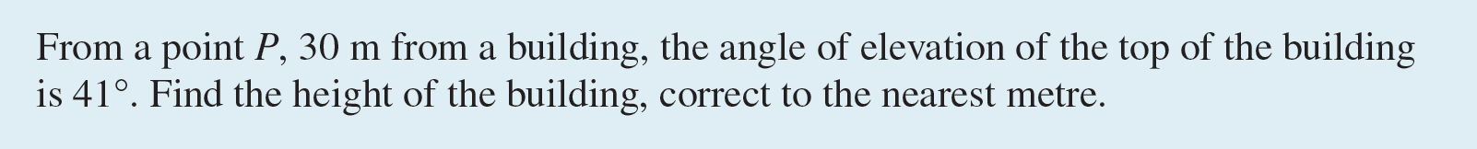
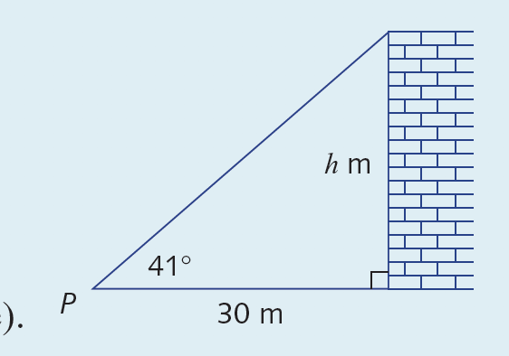

Slide 8
